Slide 1
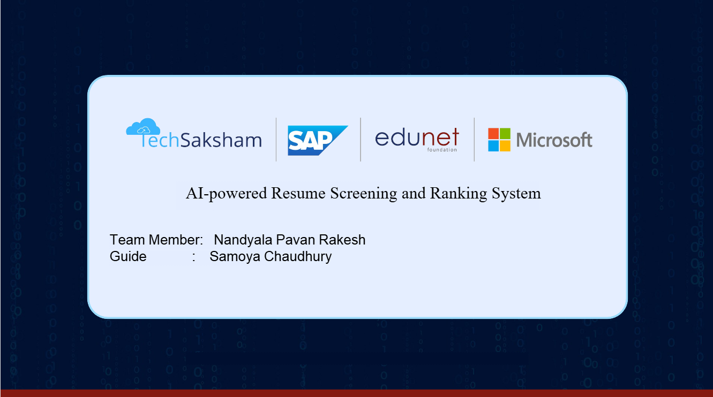

Slide 2
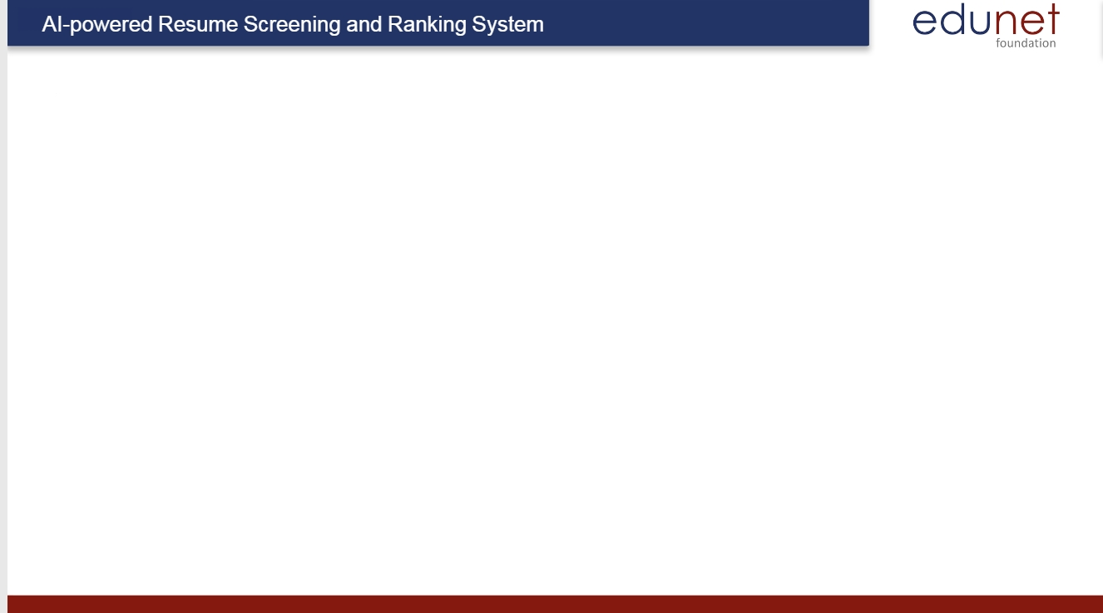
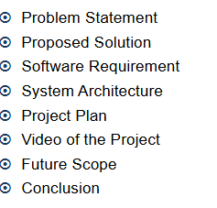
Course Outline

Slide 3
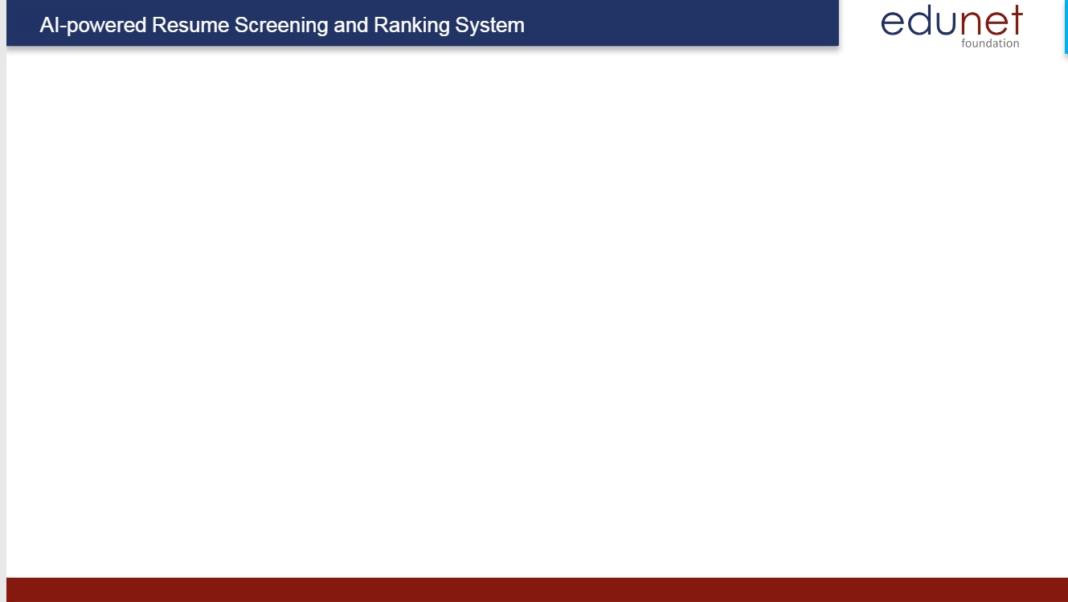

Problem Statement
Recruiters often face challenges in manually screening a large volume of resumes, leading to time-consuming and inefficient hiring processes. To address this, an AI-powered resume screening and ranking system can be developed to automate candidate evaluation based on job requirements. The system will extract key information from resumes, compare them against job descriptions, and assign relevance scores to rank candidates effectively. By leveraging AI, the solution aims to reduce hiring time, improve matching accuracy, and minimize human bias in recruitment. Ultimately, this will result in a more efficient and data-driven hiring process, enabling recruiters to make faster and better hiring decisions.

Slide 4

Proposed Solution
To address the challenges of automating the resume screening process, we propose a solution that leverages deep learning and natural language processing (NLP) techniques.
The solution will involve developing a comprehensive pipeline that handles:
Job description matching
Candidate ranking
The final product will be a web-based application that recruiters can use to streamline the initial stages of the recruitment process.

Slide 5

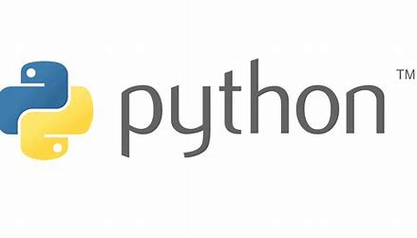
Software Requriement
Frontend (Streamlit UI)
Upload resumes via a file uploader.
Display extracted information and ranking results dynamically.
Backend (Python Processing & AI Model)
Preprocess and store parsed resume data.
Rank resumes based on experience, skills, and job match percentage
For Pdf extract text we use spacy and PyPDF2
For Key word Matching we use TF-IDF

Slide 6
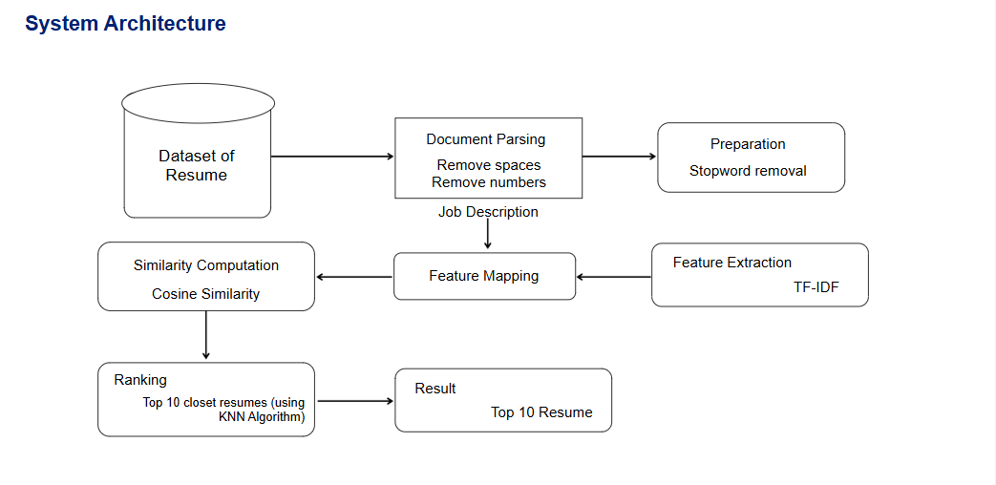
System Architecture

Slide 7
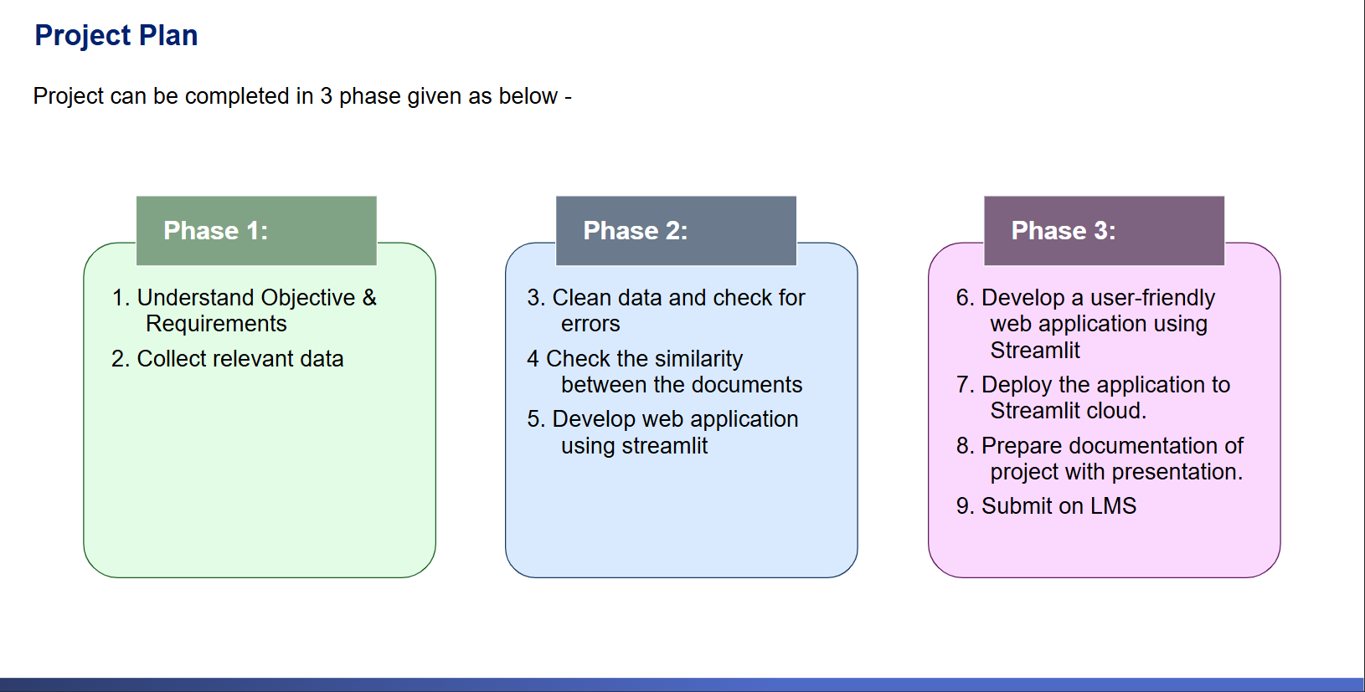

Slide 8
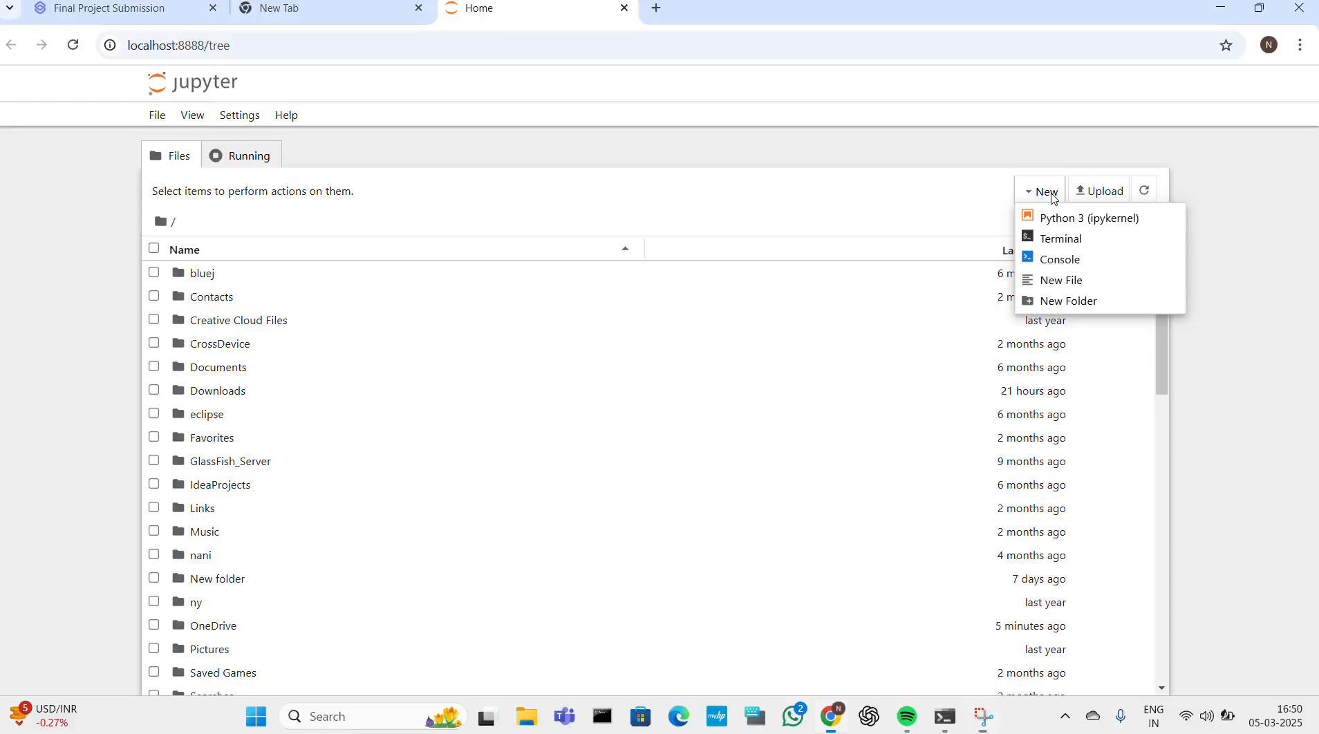
Video of Project

Slide 9
Future Scope
Here’s the future scope of your AI-powered Resume Screening and Ranking System in:
Improved Accuracy – Enhance AI models to better understand different resume formats and job descriptions.
Multi-Language Support – Expand to support resumes in multiple languages for global hiring.
Bias Reduction – Implement AI fairness techniques to reduce bias in candidate ranking.
Integration with HR Systems – Connect with ATS (Applicant Tracking Systems) for seamless hiring.
Real-Time Analysis – Enable instant screening and ranking for large-scale recruitment.
Voice & Video Analysis – Analyze candidate responses in video resumes and voice interviews.
Customizable Ranking – Allow recruiters to set custom ranking criteria for different roles.
AI-Powered Chatbots – Assist candidates and recruiters with automated queries and suggestions.
Market Expansion – Scale the system for use in educational institutions and freelancing platforms.
Data Security & Compliance – Enhance security to comply with GDPR and other hiring regulations.
Let me know if you want any changes! 🚀

Slide 10
Conclusion
AI-powered Resume Screening and Ranking System streamlines the hiring process by leveraging Natural Language Processing (NLP) and Machine Learning to efficiently analyze and rank resumes based on job requirements. By automating resume screening, this system reduces manual effort, minimizes bias, and improves hiring accuracy.
With real-time processing, customizable ranking criteria, and integration with HR systems, this tool enhances recruiter productivity and ensures that the most relevant candidates are shortlisted. The future scope includes multi-language support, AI-driven chatbots, video resume analysis, and advanced data security to further optimize recruitment workflows.
This project demonstrates how AI can revolutionize talent acquisition, making hiring faster, fairer, and more efficient for organizations worldwide. 🚀

Slide 11


